Slide 1
Innate immunity & Rheumatic diseases
A.R.Rajaei MD
arrajaei@gmail.com
Rheumatology Department
Loghman hospital

Slide 2
The immune system
The immune system has two parts:
Innate (non-specific) immune response
Acquired (specific) immune response
The innate immune response is the non-specific, first response to foreign threats. Immune cells recognize a potential threat, ring the alarm, and the inflammatory response begins.
innater immunity & Rheumatic Diseases
A.R.Rajaei MD

Slide 3
innater immunity & Rheumatic Diseases
A.R.Rajaei MD

Slide 4
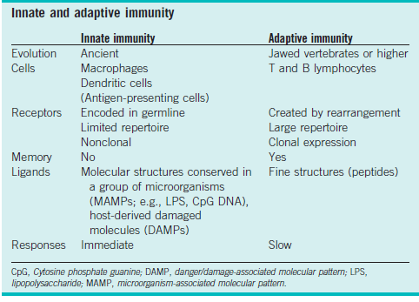
innater immunity & Rheumatic Diseases
A.R.Rajaei MD

Slide 5
Innate immunity is activated by host signals called alarmins or pathogen signals called pathogen-associated molecular patterns (PAMPs). Alarmins are endogenous molecules that are constitutively available and passively released from necrotic cells upon infection or tissue injury. They are also secreted by stimulated leukocytes and epithelia. PAMPs are molecules produced only by microbes. Both alarmins and PAMPs activate innate immunity through pattern recognition receptors (PRRs) such as Toll-like receptors (TLRs). Alarmins and PAMPs activate and recruit cells of the innate immune system including dendritic cells (DCs).
innater immunity & Rheumatic Diseases
A.R.Rajaei MD

Slide 6
High-mobility group protein B1: can be released from any cell type. Proinflammatory when bound to other alarmins and PAMPs.
S100A8/A9/A12: released by epithelial cells and phagocytes causing inflammation with increased neutrophil adhesion, migration, and release from bone marrow. Some antibacterial activity. S100A8 and S100A9 form a heterodimer called calprotectin, often measured in feces as an indication of intestinal inflammation.
Heat-shock proteins (HSP; HSP60 and HSP70): autoantigens stimulating pathways to suppress inflammation.
Interleukin (IL)-33: member of the IL-1 family with proinflammatory properties through binding IL-1 receptor like 1 (ST2) that is released by various cells including epithelia, fibroblasts, endothelial cells, osteoblasts, and immune cells.
Antimicrobial peptides (AMPs): the main AMPs are defensins, bactericidal/permeability-increasing protein permeability-increasing protein, and cathelicidins. They are secreted by epithelial cells to form a microbial shield when the physical barriers (skin and mucous membranes) become injured. The AMPs integrate into outer cell membranes of invading microbes to form pores that disrupt the microbes’ integrity. AMPs serve as chemoattractants for innate (neutrophils, DCs) and adaptive (lymphocytes) immune cells. AMPs can govern the composition of commensal microbes that colonize body surfaces. Abnormal AMP production may contribute to diseases such as psoriasis and Crohn’s disease.
innater immunity & Rheumatic Diseases
A.R.Rajaei MD

Slide 7
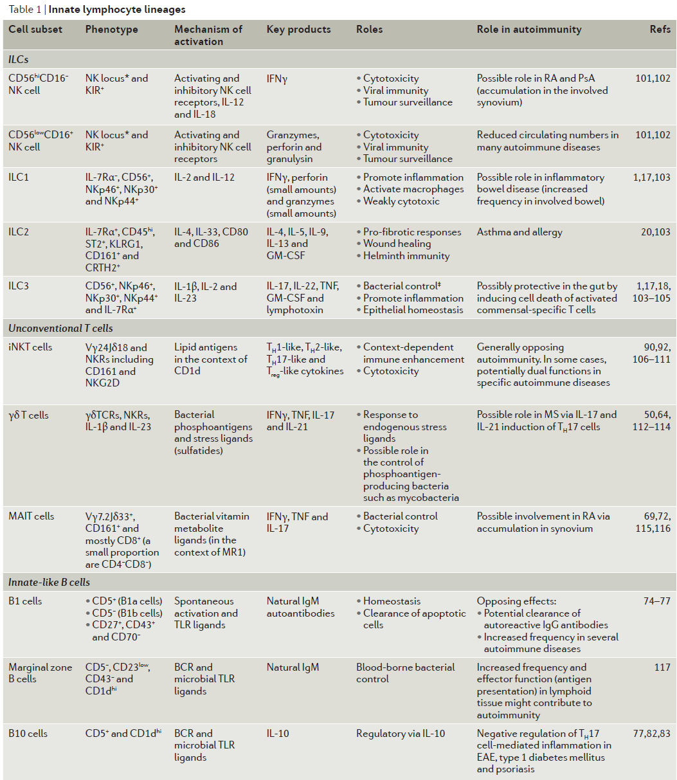
innater immunity & Rheumatic Diseases
A.R.Rajaei MD
Notes:
*The mammalian natural killer (NK) locus (reviewed elsewhere103–105) encodes C‑type lectin superfamily members (including CD94, CD161 and the NKG2 subfamily)
that are expressed on many innate lymphocytes. NK cell receptors (NKRs), including NK locus molecules, are common to NK cells, NKT cells and other innate
lymphocyte subsets. Note that the NK locus and NKRs in general are not expressed by naive B cells or T cells, but are expressed by some effector or memory
mature T cells, particularly cytotoxic CD8+ and tissue-tropic helper CD4+ memory adaptive T cell subsets. Consequently, ~25% of adult human T cells express
CD161, for example104. ‡Bacterial control refers to commensal mucosal bacteria as well as invasive pathogens. BCR, B cell receptor; CRTH2, chemoattractant
receptor-homologous molecule expressed on T helper type 2 (TH2) cells (also known as prostaglandin D2 receptor 2); EAE, experimental autoimmune
encephalomyelitis; GM‑CSF, granulocyte–macrophage colony-stimulating factor; IL‑7Rα, IL‑7 receptor‑α; ILC, innate lymphoid cell; iNKT, invariant NKT; KIR, killer
cell immunoglobulin-like receptor; KLRG1, killer cell lectin-like receptor subfamily G member 1; MR1, MHC class I‑related molecule; MS, multiple sclerosis;
PsA, psoriatic arthitis; RA, rheumatoid arthritis; ST2, interleukin‑1 receptor-like 1; TCR, T cell receptor; TLR, Toll-like receptor.

Slide 8
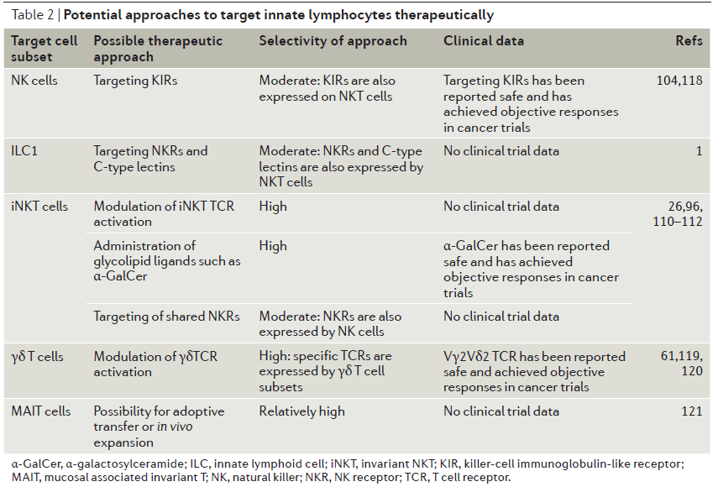
innater immunity & Rheumatic Diseases
A.R.Rajaei MD

Slide 9
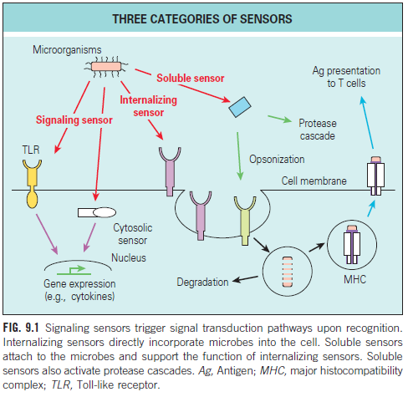
innater immunity & Rheumatic Diseases
A.R.Rajaei MD

Slide 10
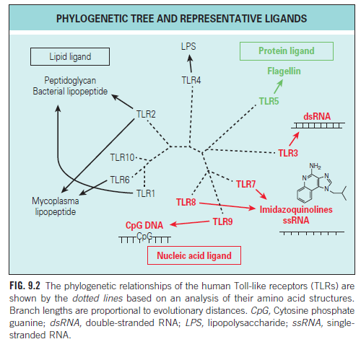
innater immunity & Rheumatic Diseases
A.R.Rajaei MD

Slide 11
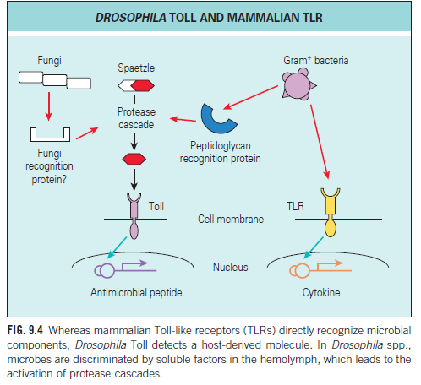
innater immunity & Rheumatic Diseases
A.R.Rajaei MD

Slide 12
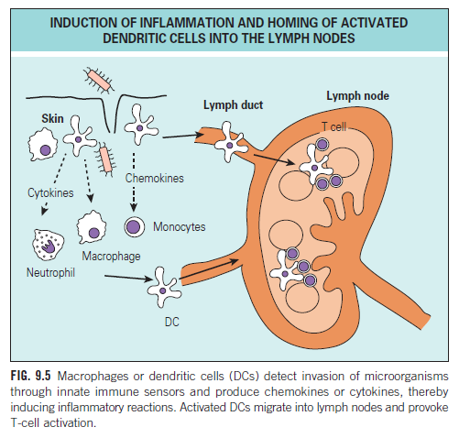
innater immunity & Rheumatic Diseases
A.R.Rajaei MD

Slide 13
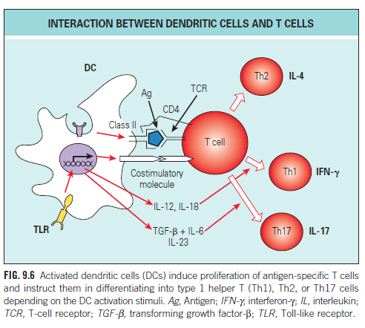
innater immunity & Rheumatic Diseases
A.R.Rajaei MD

Slide 14
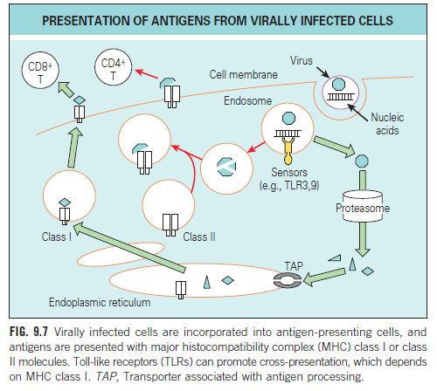
innater immunity & Rheumatic Diseases
A.R.Rajaei MD

Slide 15
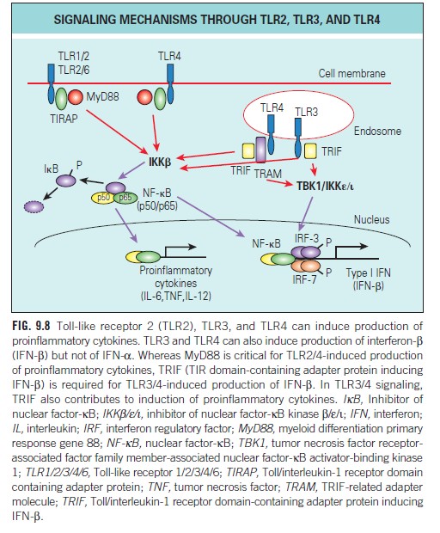
innater immunity & Rheumatic Diseases
A.R.Rajaei MD

Slide 16
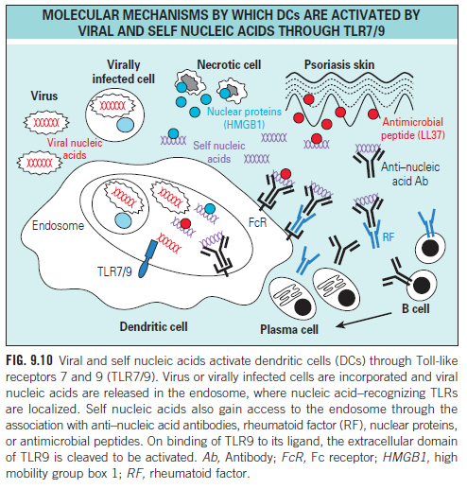
innater immunity & Rheumatic Diseases
A.R.Rajaei MD

Slide 17
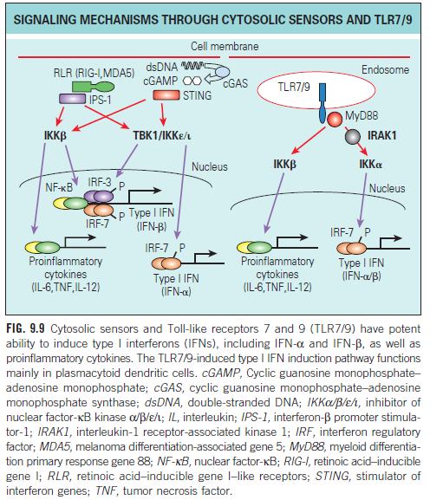
innater immunity & Rheumatic Diseases
A.R.Rajaei MD

Slide 18
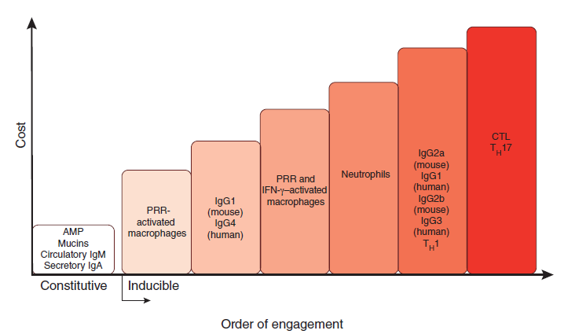
innater immunity & Rheumatic Diseases
A.R.Rajaei MD
Notes:
The order of effector function
engagement, from lowest cost to highest cost.
Defense mechanisms of the immune system
have different costs to host fitness. The order of
engagement of effector functions corresponds
to their increasing costs (here, their potential to
cause immunopathology). The low-cost effector
mechanisms, such as antimicrobial peptides
(AMPs), secretory IgA and circulatory IgM,
are expressed constitutively. When they are
insufficient to contain pathogens, the response of
next lowest cost is induced (here, tissue-resident
macrophages); when this response is insufficient,
neutrophils are recruited, and so on. The
examples of effector responses presented here
and their costs are for illustration purposes only;
they are neither comprehensive nor quantitative.

Slide 19
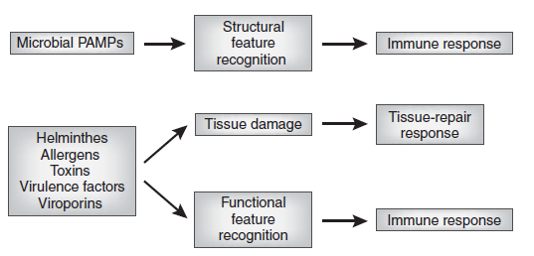
innater immunity & Rheumatic Diseases
A.R.Rajaei MD
Notes:
Recognition of structural and functional features. Sensors of the
innate immune system recognize infectious agents through detection of
unique molecular structures associated with the pathogens (structural feature
recognition) or through detection of the characteristic functional activities
(functional feature recognition) associated with the infection. The process of
infection is often accompanied by tissue damage caused by the pathogens or
by the immune response to pathogens. Tissue damage induces a tissue-repair
program that can include some specialized immune responses.

Slide 20
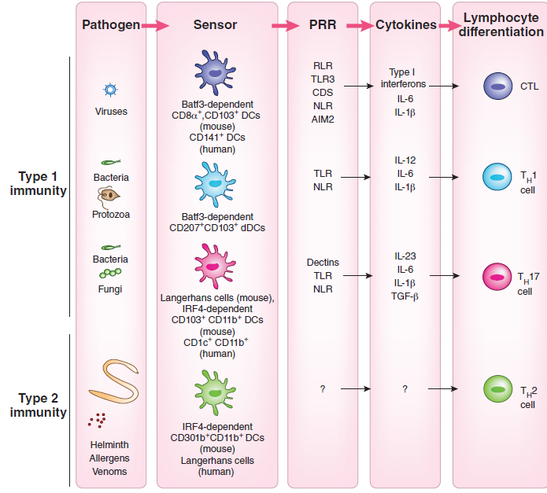
innater immunity & Rheumatic Diseases
A.R.Rajaei MD
Notes:
The instruction of various classes of
T cell responses by DCs. The development and
function of DCs in vivo requires transcription
factors that are critical for each stage of their
differentiation program. Studies probing the
requirement or sufficiency for DC subsets have
suggested a relationship between the DC lineage
and T cell programming. CTL responses are
induced by lymphoid organ-resident, Batf3-
dependent CD8a+ DCs and tissue CD103+ DCs
(mouse) and the human CD141+ DC counterpart.
TH1 cell-mediated immunity requires stimulation,
in a GM-CSF-dependent manner, by the
CD207+CD103+ DC subset, a minor population of
dermal DCs (mouse). TH17 responses are induced
by mucosal IRF4-dependent CD103+CD11b+ DCs
as well as by skin Langerhans cells, depending on
the location of the pathogen (mouse). The human
CD1c+ DCs prime TH17 cell responses. Finally,
TH2 cell-mediated immunity requires IRF4-
dependent CD301b+CD11b+ DCs (mouse). These
DCs comprise the majority of dermal DC (dDC)
population and are distinct from CD207+ CD103+
dermal DCs. In contrast, human Langerhans cells
induce TH2 cytokine secretion ex vivo.

Slide 21
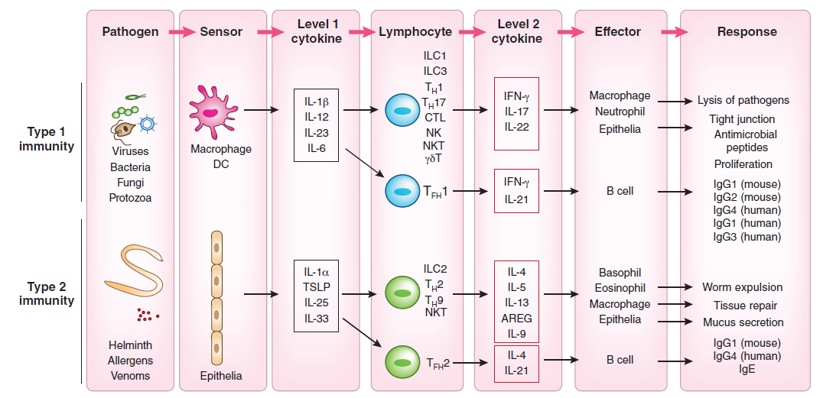
innater immunity & Rheumatic Diseases
A.R.Rajaei MD
Notes:
The two-tiered design of the immune responses. Immune responses are orchestrated by three categories of cells that function as ‘sensors’ that
detect pathogens and secrete ‘level 1’ cytokines, the tissue-resident lymphocytes that respond to ‘level 1’ cytokines to secrete ‘level 2’ cytokines, and the
effector cells that respond to ‘level 2’ cytokines to carry out effector functions to eliminate the pathogen. DCs and macrophages serve as sensors for the type
1 immune response and epithelial cells and mast cells for the type 2 immune response. ‘Level 1’ cytokines act on terminally differentiated lymphocytes,
including ILCs, ILLs, TFH cells and TRM cells. In response to ‘level 1’ cytokines, these lymphocytes produce ‘level 2’ cytokines. The ‘level 2’ cytokines
act on the effector cells of the immune response. These include macrophages, neutrophils, epithelial cells, eosinophils and basophils, B cells as well as
sensory neurons, endothelium and smooth muscle cells. These cells perform diverse effector functions, including barrier defenses, killing and expulsion of
pathogens, antibody production and tissue repair.

Slide 22
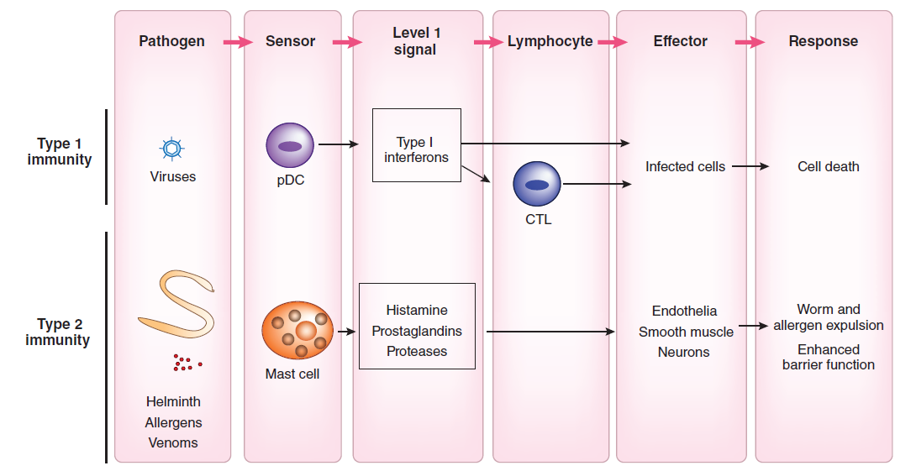
innater immunity & Rheumatic Diseases
A.R.Rajaei MD
Notes:
Single-tiered immune responses. Some immune responses involve only the ‘level 1’ signals that act directly on the effector cells. For antiviral
responses, plasmacytoid DCs serve as a key sensor for the detection of viruses through endosomal TLRs to induce type 1 interferons, which block
viral replication. Mast cells that reside in the mucosa sense the presence of the noxious substances and parasitic worms and release histamines and
prostaglandins, which act on local vasculature to induce vasodilation and leakage, and intestinal and airway smooth muscles to induce peristalsis,
contraction and expulsion of parasites. Histamine produced by mast cells and TSLP produced by epithelial cells can also stimulate a subset of C-fiber
neurons to induce the itching sensation.

Slide 23
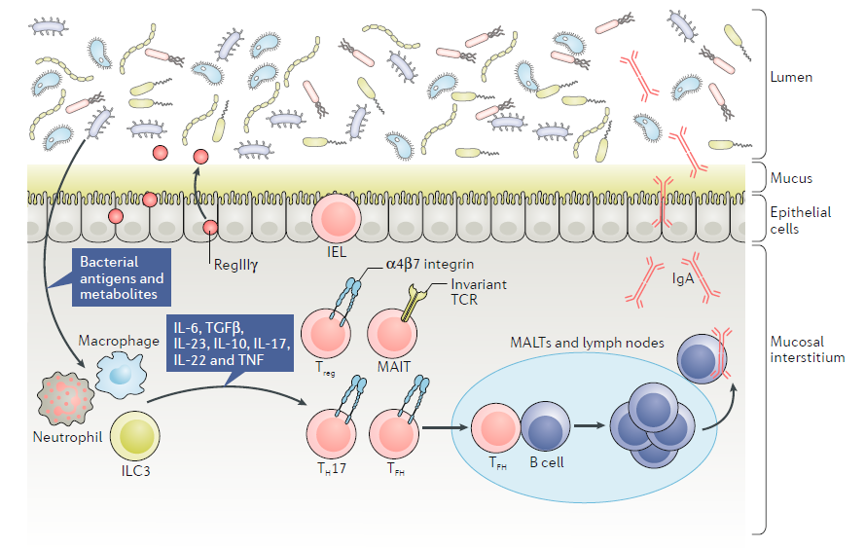
local immune system and microbial factors that interact in the mucosal environment
innater immunity & Rheumatic Diseases
A.R.Rajaei MD
Notes:
local immune system and microbial factors that interact in the mucosal environment. Illustrated are
components of the bidirectional regulation between the luminal microbiome and the cells within the mucosal interstitium,
as well as within mucosa- associated lymphoid tissue (MALT) and lymph nodes (such as the Peyer’s patches and
mesenteric lymph nodes of the gut), with several cell types contributing individually to produce protective factors.
Specific examples include mucosal- associated invariant T (MAIT) cells that produce IL-17 , whereas type 3 innate lymphoid
(ILC3) cells are responsible for producing IL-22. In addition, circulating CD4+ and CD8+ T cells survey antigens in this
region, the responses to which are regulated by regulatory T (Treg) cells as well as cytokines, including IL-17 , IL-10, IL-22,
IL-23, IL-6 and TNF family members. Antimicrobial peptides, such as microbicidal protein RegIIIγ, have important roles in
limiting barrier breaks, as do immunoglobulin A (IgA) antibodies, macrophages, dendritic cells and T helper 17 (TH17) cells.
Neutrophils play key roles in mucosal protection from infection, and α4β7 integrinhigh CD4+ T cells preferentially migrate
to these sites. IELs, intraepithelial lymphocytes; TCR , T cell receptor ; TFH, T follicular helper cell; TGFβ, transforming
growth factor- β.

